Slide 1


Slide 2


Sustanify
Second Year Project Final Presentation
Submitted by
ROLL | NAME
2301010308 | Yash Chauhan
2301010327 | Prabhat Kumar
2301010333 | Lakshay
2301010337 | Om Prajapati
Industry Mentor: Yatish Singhal
Faculty Mentor: Tanvi Chawla
Notes:
New Courses replaced with New Programmes

Slide 3

Project Overview
Sustainability is becoming more important as climate change, pollution, and resource depletion continue to rise. Many people want to adopt eco-friendly habits but due to lack of awareness, proper guidance, or the right tools to track their impact.
This project aims to fill this gap by developing a digital prototype that helps users to understand their carbon footprint, receive AI-driven sustainability tips, and explore eco-friendly product recommendations. By using interactive quizzes, real-time data tracking, and personalized insights, it makes learning about sustainability more engaging, accessible, and practical for everyday life.
Notes:
New Courses replaced with New Programmes

Slide 4
About the Problem
Problems Identified
Sustainability is a growing concern, but many people have lack of awareness and proper guidance on how their daily activities impact the environment. Without clear tracking or recommendations, individuals find it difficult to reduce their carbon footprint effectively.
Problems
Lack of Awareness – Many people do not know how their lifestyle choices affect the environment.
No Personalized Guidance – Existing resources provide general information, but not tailored suggestions based on individual habits.
Limited Engagement – Most sustainability platforms rely on static content, making learning less interactive and engaging.
Notes:
New Courses replaced with New Programmes

Slide 5
About the Problem
Need for a Solution
To encourage sustainable living, there is a need for a simple, engaging, and personalized platform that helps users:
Track their carbon footprint in real-time.
Find eco-friendly product recommendations to make better choices.
Engage with interactive tools like quizzes and sustainability challenges.
Get AI-based personalized recommendations for reducing environmental impact.
Notes:
New Courses replaced with New Programmes

Slide 6
About the Problem
Existing Solutions & Their Limitations
Existing Solution | Limitations
General sustainability blogs & websites | Provide only text-based information, making it less engaging.
Carbon footprint calculators | Many do not offer real-time tracking or personalized insights.
Eco-friendly product websites | Lack AI-driven recommendations based on user preferences.
Environmental awareness campaigns | Focus on awareness but lack tools for tracking personal impact.
Notes:
New Courses replaced with New Programmes

Slide 7
About the Problem
How Sustanify Solves These Issues
Real-time carbon footprint tracking with personalized AI-based insights.
Interactive quizzes & gamified learning to keep users engaged.
AI-powered product recommendations for sustainable shopping.
User dashboard to track progress & eco-friendly habits over time.
Notes:
New Courses replaced with New Programmes

Slide 8
Problem Statement
Sustainability has become a major global concern due to rising carbon emissions, pollution, and resource depletion. Many individuals want to adopt eco-friendly habits but lack awareness, proper tools, and guidance to track and reduce their environmental impact.
Existing solutions, such as general sustainability blogs and static carbon footprint calculators, do not provide personalized insights or interactive engagement, making it difficult for users to take meaningful action.
Notes:
New Courses replaced with New Programmes

Slide 9
Problem Statement
Why Is It Important?
Lack of Awareness & Engagement – Without clear and interactive educational tools, many people remain unaware of their impact
Climate Change & Environmental Damage – Unchecked carbon emissions contribute to global warming, extreme weather, and ecosystem destruction.
Need for Data-Driven Decision Making – People require real-time tracking and AI-powered recommendations to make sustainable lifestyle choices effectively.
Notes:
New Courses replaced with New Programmes

Slide 10
Problem Statement
Expected Impact of Solving This Problem
Increased Environmental Awareness – Users will learn how daily habits contribute to climate change.
Reduced Carbon Footprint – Personalized AI recommendations will help individuals adopt greener alternatives.
Data-Driven Sustainable Choices – A real-time tracking system will motivate users to track progress and make better decisions.
Long-Term Behavioral Change – Interactive tools like quizzes and recommendations will encourage users to build eco-friendly habits over time.
Notes:
New Courses replaced with New Programmes

Slide 11
Objectives
Sustainable practices for everyday life Making eco-friendly choices can be simple. Everyone can start small and gradually adopt sustainable habits that helps to reduce their environmental impact.
AI-driven recommendations & personalized guidance Our AI learns from your habits and preferences, offering personalized suggestions for sustainable products and actions that suit your lifestyle. It makes going green easy and practical.
Interactive quizzes for sustainability knowledge Through fun and engaging quizzes, users can test their knowledge, learn new facts, and discover how they can contribute to environmental conservation. It’s an enjoyable way to become more eco-conscious.
Notes:
New Courses replaced with New Programmes

Slide 12
Methodology, Tools, and Techniques
Approach to Solve the Problem
Sustanify helps users adopt sustainable practices through tools like the Carbon Footprint Calculator, which estimates their environmental impact based on daily activities.
This feature uses real-time data analysis to provide personalized insights and suggests ways to reduce carbon emissions through eco-friendly choices.
Notes:
New Courses replaced with New Programmes

Slide 13
Methodology, Tools, and Techniques
Tools, Software, and Techniques Used
Carbon Footprint Calculator – Real-Time Data Analysis
The calculator estimates carbon emissions based on user inputs such as energy usage, transportation habits, and lifestyle choices.
Data Input: Users enter details on energy consumption, travel, and daily habits.
Emission Factors: Each input is assigned an emission factor based on environmental standards.
Footprint Computation: The system sums the emissions, giving users a total carbon footprint, compared to national/global averages.
Notes:
New Courses replaced with New Programmes

Slide 14
Methodology, Tools, and Techniques
Frontend Development: JavaScript & React.js React.js was chosen for its efficient, scalable, and modular component-based structure, making it perfect for dynamic applications.
Component-based: Easy to maintain and expand.
Fast Rendering: Virtual DOM improves performance.
Rich Ecosystem: Offers many libraries for enhanced UI/UX.
Backend Development: Firebase Firebase was selected for authentication, real-time data management, and scalability.
Firestore: Real-time updates to user data.
Authentication: Secure sign-in methods like Google and email.
Scalability: Efficient handling of growing user data.
Hosting: Secure deployment with SSL encryption.
Notes:
New Courses replaced with New Programmes

Slide 15
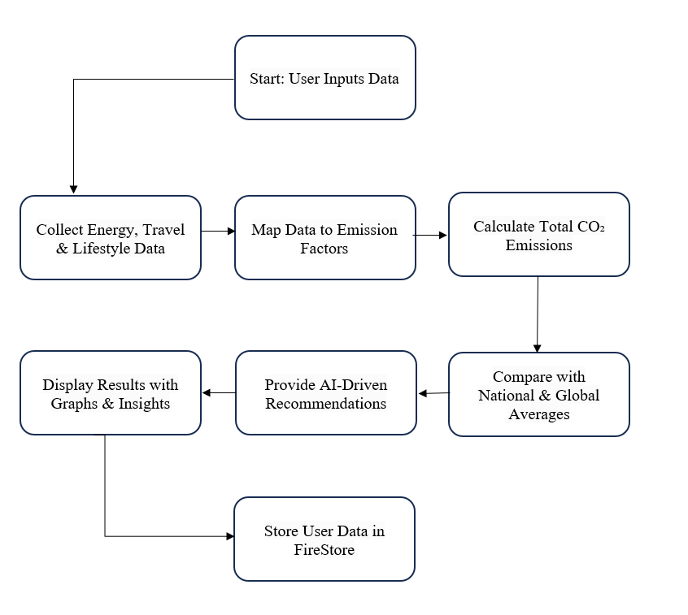
Methodology Flowchart
Notes:
New Courses replaced with New Programmes

Slide 16
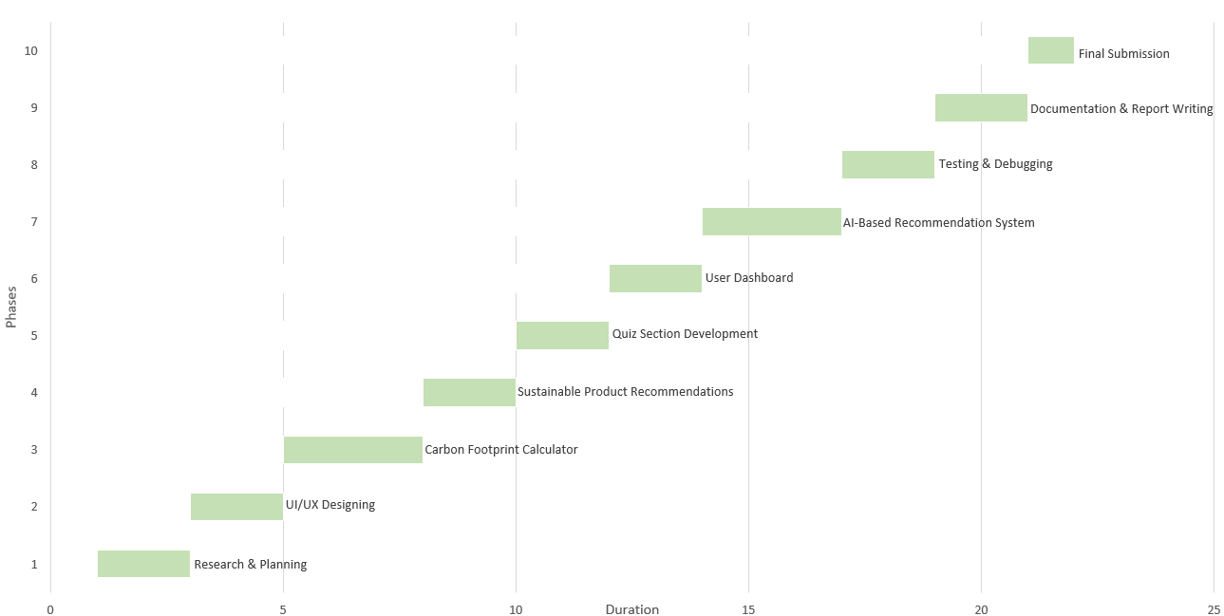
Project Timeline
Gantt chart or timeline graph
Breakdown of project phases
Estimated duration for each phase
Notes:
New Courses replaced with New Programmes

Slide 17
Expected Results & Impact
Expected Results:
Impact:
Increased user engagement through interactive quizzes and eco-friendly challenges.
Enhanced awareness about sustainable living practices.
Positive feedback from users about the content and features.
Growth in website traffic, particularly from sustainability-focused communities.
Improved user behavior towards eco-friendly products and actions.
Empowering individuals to make informed, eco-conscious decisions.
Encouraging long-term environmental responsibility and positive behavioral shifts.
Building a global community that actively participates in sustainability.
Shaping future market trends toward eco-friendly solutions.
Notes:
New Courses replaced with New Programmes

Slide 18
References
Akenji, L. (2014). Consumer scapegoatism and limits to the sustainability discourse. Environmental Sociology, 1(2), 99-108. https://doi.org/10.1080/23251042.2014.981741
Jackson, T. (2009). Prosperity without growth: Economics for a finite planet. Sustainable Development Commission. Retrieved from: https://www.sd-commission.org.uk/publications.php?id=914
Choi, J., & Pak, A. (2006). Multidisciplinary, interdisciplinary, and transdisciplinary in health care. Academic Medicine, 81(6), 513-521. https://doi.org/10.1097/01.ACM.0000221705.81793.24
Sachs, J. D. (2015). The Age of Sustainable Development. Columbia University Press. ISBN 978-0231173148.
Environmental Protection Agency (EPA). (n.d.). Sustainable Management of Materials. Retrieved from: https://www.epa.gov/smm
Notes:
New Courses replaced with New Programmes

Slide 19
THANK YOU

